Slide 1
ABP FRAMEWORK:
How it started,
How it’s going…
Notes:
Good morning, good afternoon or good evening whatever the time zone you’re in…
Thank you for joining us today.
I’m Alper, from the ABP development team,
Today, I’m going to shed light on the innovative work of Volosoft, give you brief notes about how we started, and the point we have reached.

Slide 2
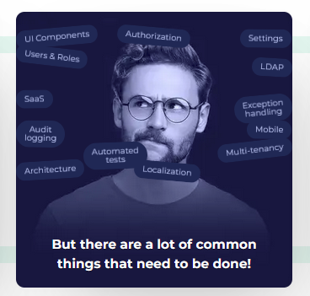
We save your time by providing common application requirements as a pre-built Visual Studio solution
Notes:
Me and the ABP Framework's brain team have been .NET developers since the early 2000s. (two thousands)
We have created many projects from scratch throughout our development life.
And we saw that we were repeating the same things every time.
The only thing that changed was the business logic.
And there were dozens of features in common.
We started our journey to not reinvent the wheel on every new project.
We decided to make it project open-source.
And after seeing the great interest of people, we decided that we should devote full time to this project.
At this point, three friends quitted from the previous company, founded Volosoft to focus on this project full-time.
The name of the project started our journey was ASP.NET Boilerplate.

Slide 3
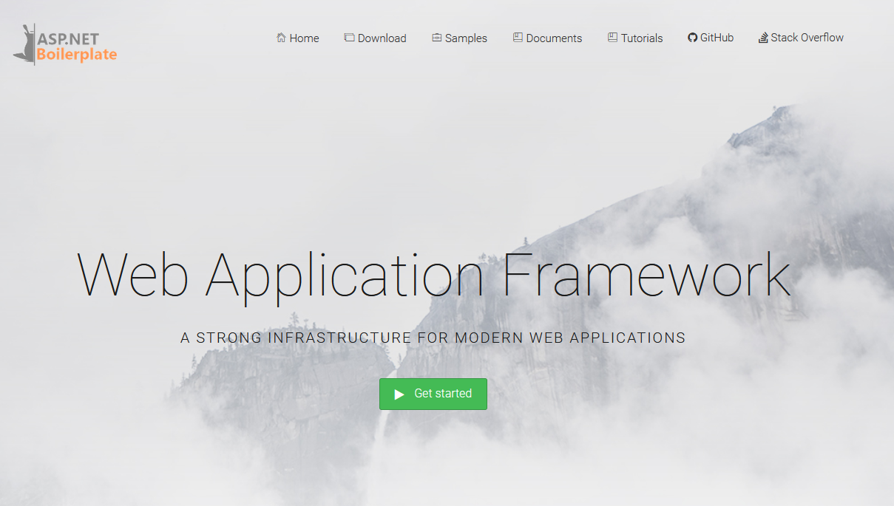
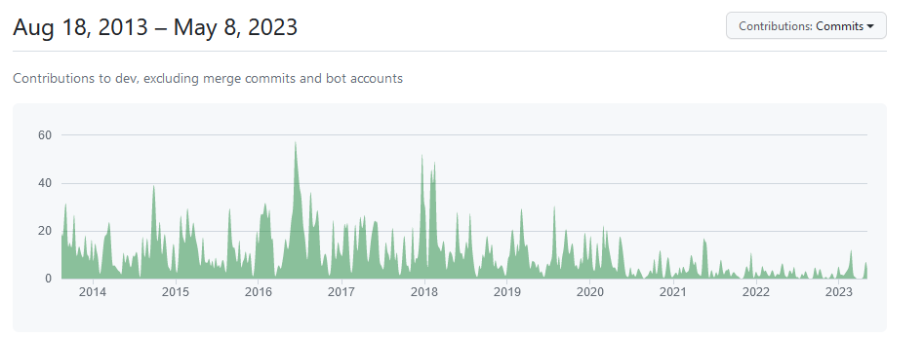
https://aspnetboilerplate.com
Notes:
We came with a very simple and impactive slogan: Don't spend your valuable time to re-create login, authentication, user management, localization, audit logging, multi-tenancy, exception handling system and so on...
⏭️
And it has been a long time since we started this project.
From 2013 (twenty thirteen) until now.

Slide 4

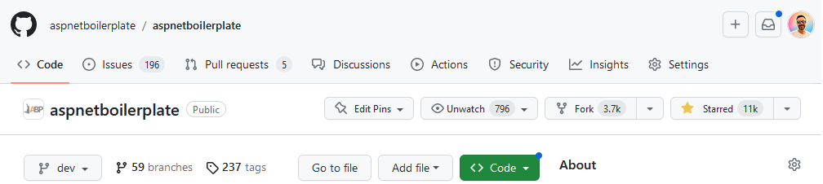
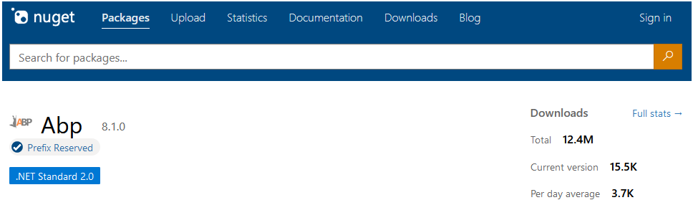
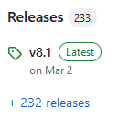
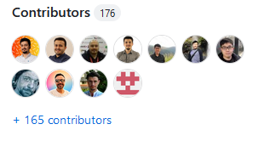
https://aspnetboilerplate.com
Notes:
The project was so popular among the .NET developers ⏭️ that it reached 11K stars on GitHub ⏭️ 12 million NuGet downloads have been made so far
⏭️ And we have released a total of 232 (two hundred thirty two) versions ⏭️ 176 (one hundred seventy six) software developers contributed to this project.

Slide 5

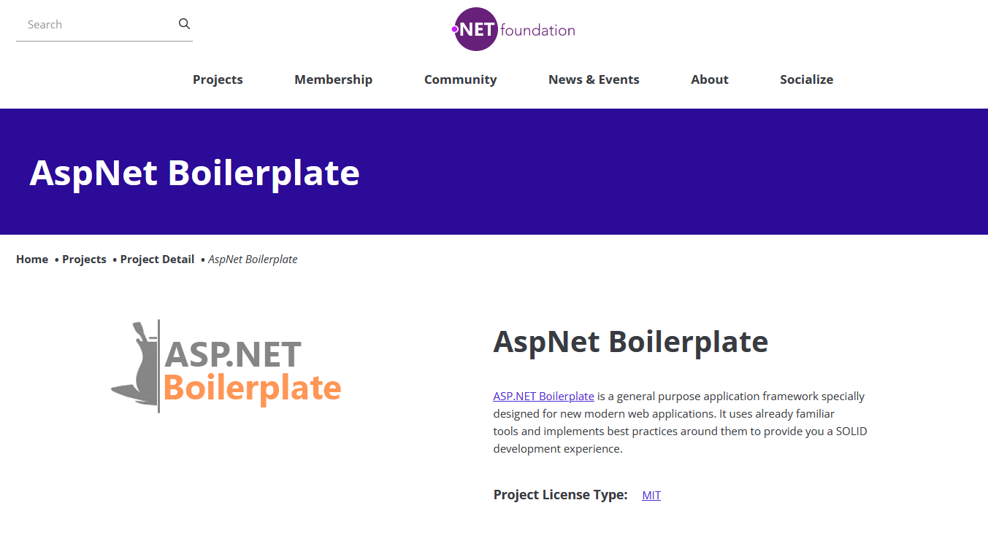
Notes:
And the project succeeded in entering under the umbrella of the .NET Foundation.
Today, there are hundreds of projects and systems currently using ASP.NET Boilerplate.

Slide 6
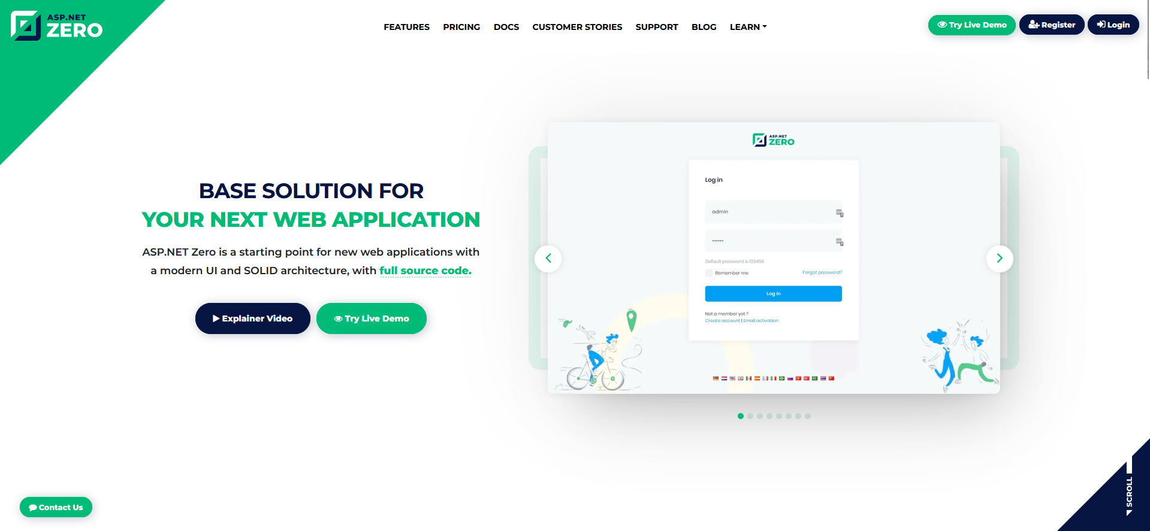
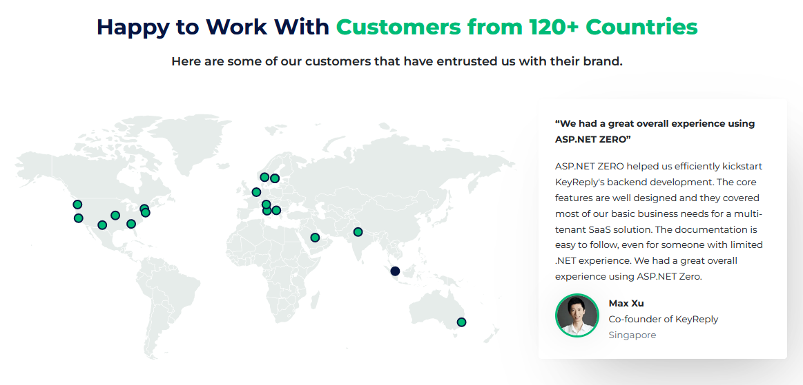
https://AspnetZero.com
Notes:
In order to continue the success we have achieved from ASP.NET Boilerplate and to survive our company,
we have implemented a new project called ASP.NET Zero for enterprise companies and users who want more advanced features.
This project has been using the open-source ASP.NET Boilerplate under the hood.
But this time we used a paid theme called Metronic in ASP.NET Zero.
The .NET developers loved ASP.NET Zero.
We made a tool that generates CRUD pages, and we implemented line of business features like LDAP and account security features in this project.
We also provided premium support to our customers.
And finally, with the money we earned, we could continue our open-source, new projects and contribute to other open-source projects.

Slide 7
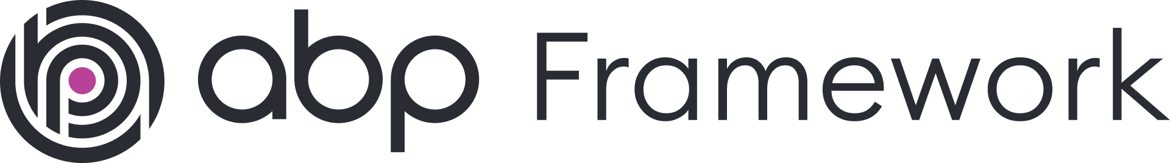
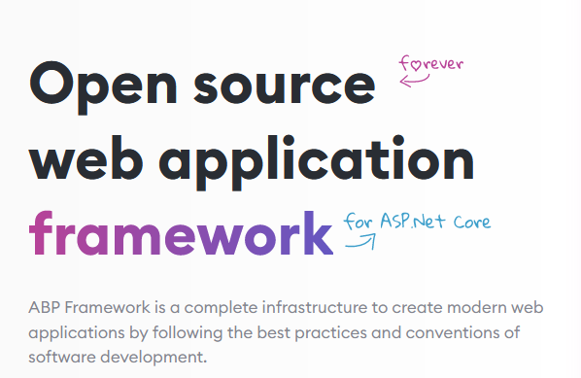
Some of the features
Background Jobs
DDD Infrastructure
Auto REST APIs
Dynamic Client Proxies
Multiple Database Providers
Data filtering
Test Infrastructure
Audit Logging
Object to Object Mapping
Email & SMS Abstractions
Localization
Setting Management
Extension Methods
Aspect Oriented Programming
Dependency Injection
Modularity
Multi-Tenancy
Bootstrap Tag Helpers
Dynamic Forms
Authentication
Authorization
Distributed Event Bus
BLOB Storing
Text Templating
Tooling: ABP CLI
Cross Cutting Concerns
Bundling & Minification
Virtual File System
Theming
https://abp.io
Notes:
As you know things change rapidly in software development, and fundamentals are key to adapting quickly.
In recent years, microservices Architecture and modular software development trends have attracted much attention.
Some of the projects started with micro-service architecture, some out of necessity and some just because of the trend.
Although ASP.NET Boilerplate is a powerful and rock-solid framework, it still needs to fully meet modularity and microservice infrastructure requirements.
So we sat down and decided to write a framework from scratch.
The name of this project is ABP Framework which gave its name to this conference and that we will spend our efforts on for many years.
Some fellows call it abp.io for short, but both are accepted.

Slide 8
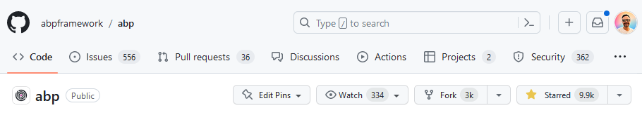
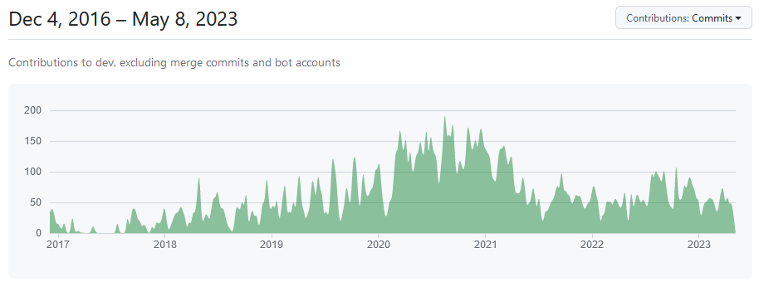
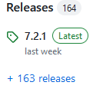
Notes:
ABP Framework has been developed as open source ⏭️ since 2016 (twenty sixteen). ⏭️
We have released 164 (one hundred sixty four) versions so far. ⏭️
It reached almost 10K stars on GitHub.

Slide 9
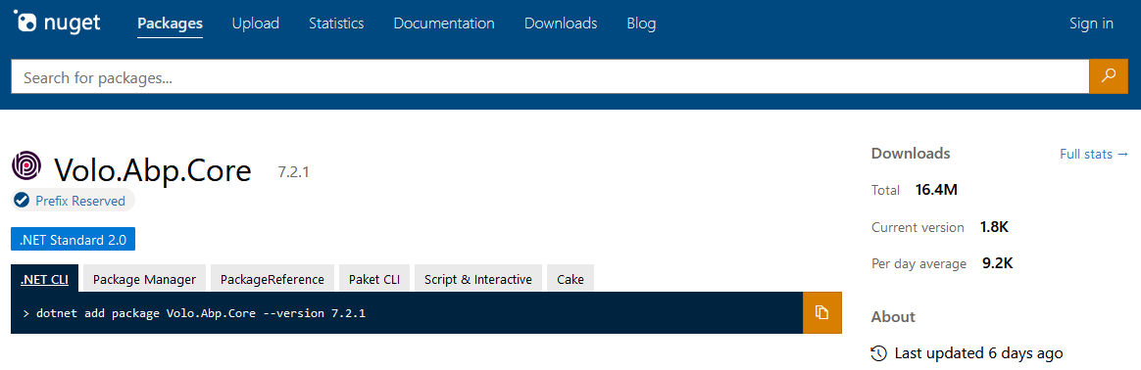
Notes:
And 16 million downloads on NuGet until now.

Slide 10


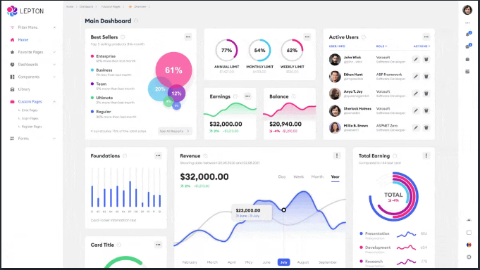
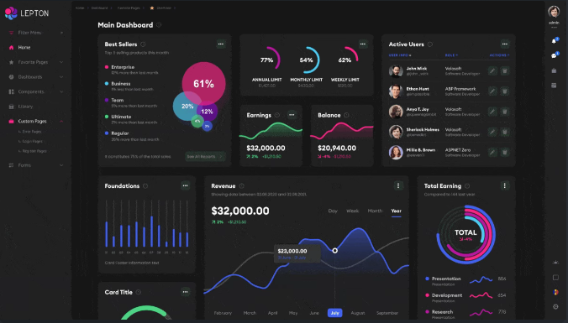
A complete
Web Development
Platform
Pre-built application modules, advanced startup templates, rapid application development tooling, professional UI themes and premium support.
Notes:
While ABP Framework is an open-source and free project, we made the ABP Commercial for enterprise companies and users who need high-end features. This product is again built on the ABP Framework. In the paid version, we offer a CRUD page generator called Suite, ready-made modules, and a stylish theme. Our dedicated team provides premium support for the paid version.
It is a project with a perfectly implemented multi-tenancy infrastructure. Its reputation has already spread among .NET developers around the world.

Slide 11
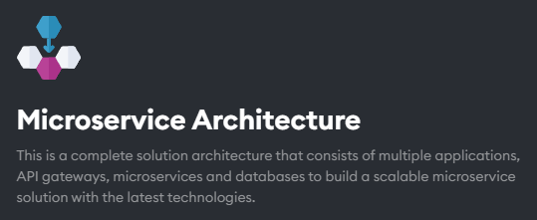
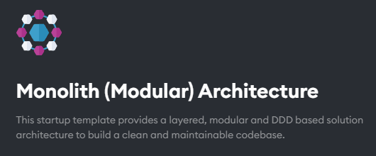
Notes:
Whether you are planning to build a lightweight application with Monolithic Architecture, or a complex, scalable, evolving application with clear domains, the ABP microservice templates are the best choices for your next project. All the templates are layered with DDD and comes with best practices applied.

Slide 12

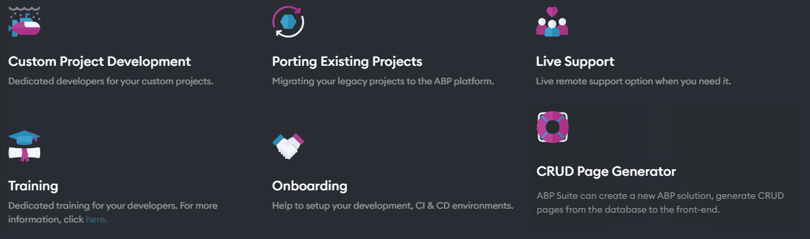
Notes:
With the paid version, we provide also custom development, live support, trainings, and tools for maintaining your ABP project.

Slide 13
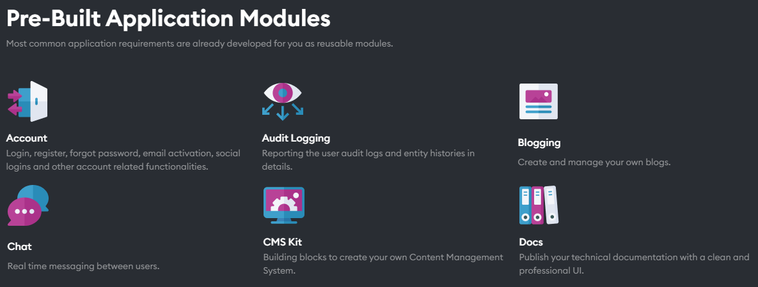
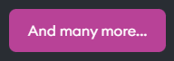
Notes:
There are several pre-built modules to kick start your project.
GDPR module, Audit Logging module, Chat module, Account module
Language Management, Forms, CMS module, File Management module
Payment module, SMS module, Blogging and Documentation module.
There are many ready to use modules (with the help of ABP modularity system.)

Slide 14
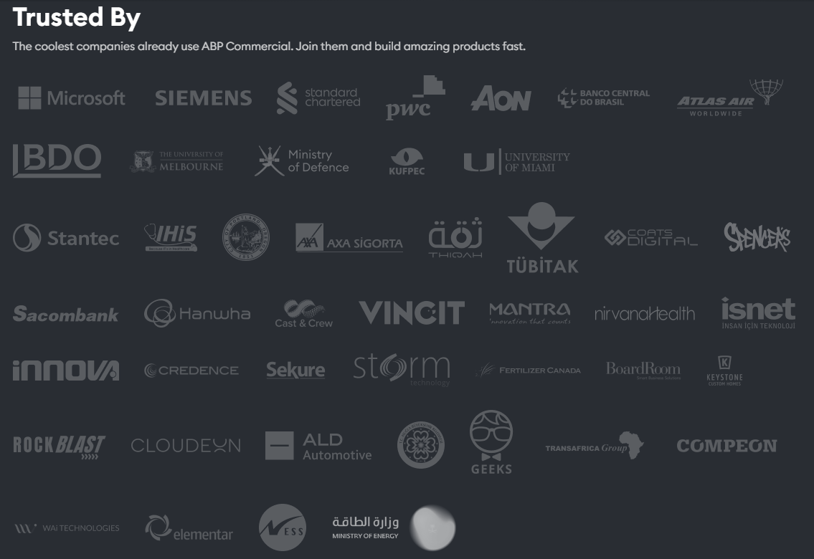

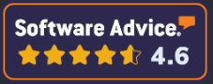

Notes:
It’s already being used by world leading companies like Microsoft, Siemens, international banks, government institutions
and ⏭️ rated high scores by the users on Capterra , Software Advice and GetApp

Slide 15
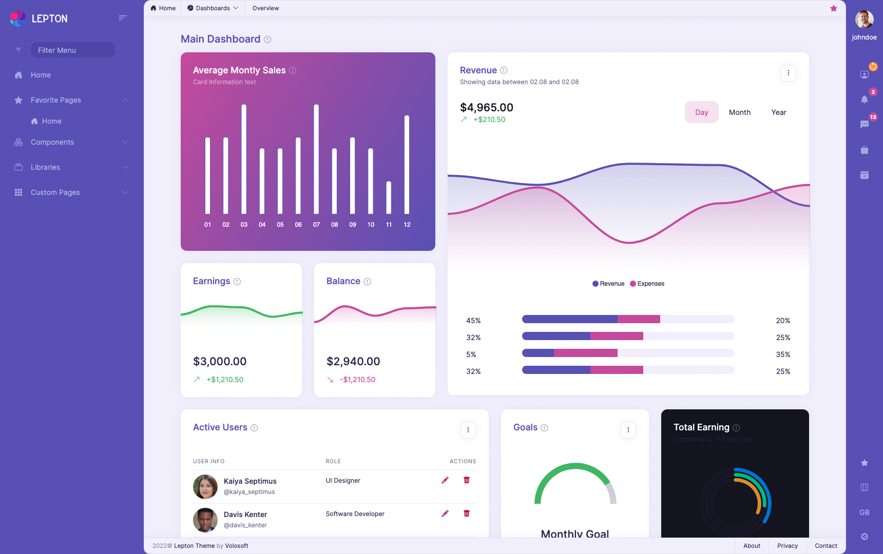



https://www.LeptonTheme.com
Supports
Notes:
We didn't just make frameworks and project templates.
Our UI Design team has also built a standalone theme. It supports MVC, Angular and Blazor user interfaces.

Slide 16
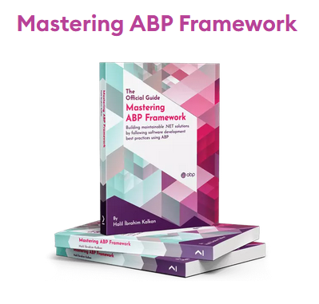
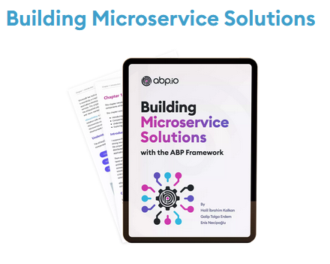
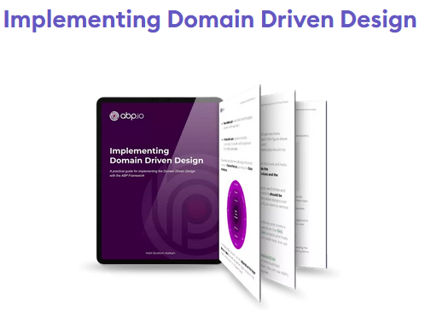
https://abp.io/Books
Notes:
On the other hand, we write books to teach ABP better and to transfer our experiences to the other developers.
Mastering ABP Framework: helps you gain a complete understanding of the framework.
Implementing Domain Driven Design: is a practical guide for implementing the DDD.
Building Microservice Solutions book is a reference guide for developing and managing microservice-based applications using the ABP Framework.

Slide 17
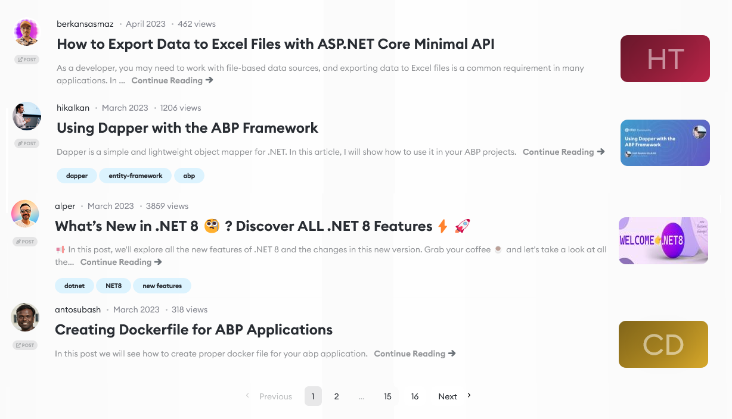
https://Community.abp.io
Notes:
Community.abp.io is the address where ABP Framework users and .NET developers post articles and watch training videos. On this site, users get informed about ABP's development progress and ABP-related events.

Slide 18
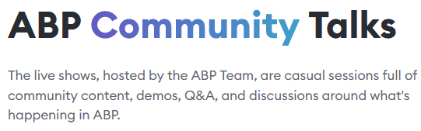
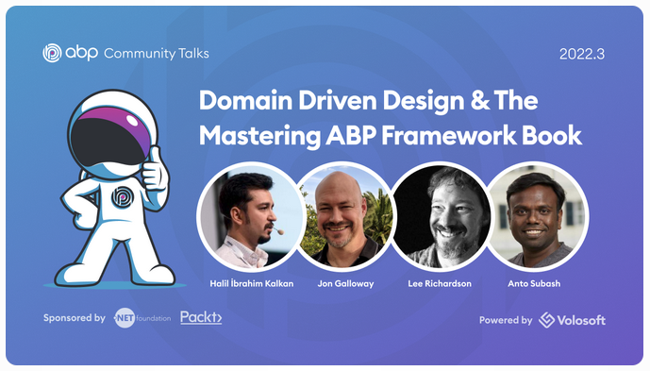
https://community.abp.io/Events
Notes:
Another thing is ABP Community Talks…
These monthly live shows, hosted by the ABP Team, are casual sessions packed with community content, demos, Q&A, and discussions around what's going on in .NET and ABP.

Slide 19

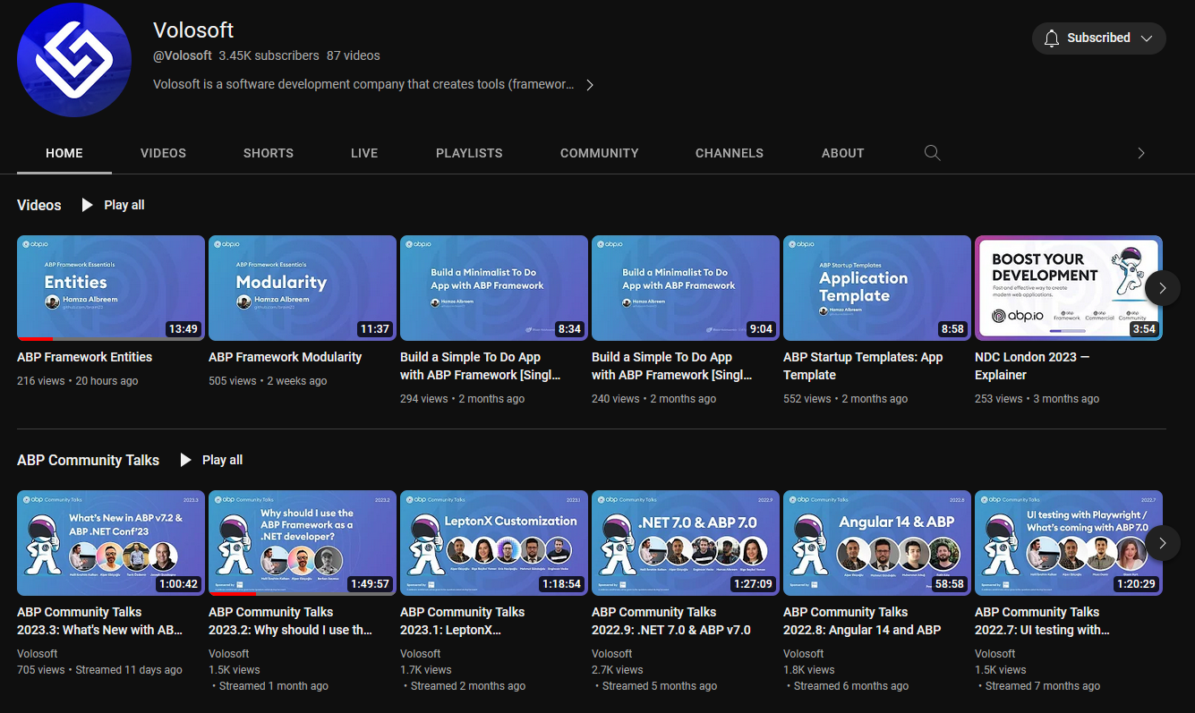
https://youtube.com/c/Volosoft
Notes:
To reach our past events, tutorials and training videos. Check out our YouTube channel

Slide 20
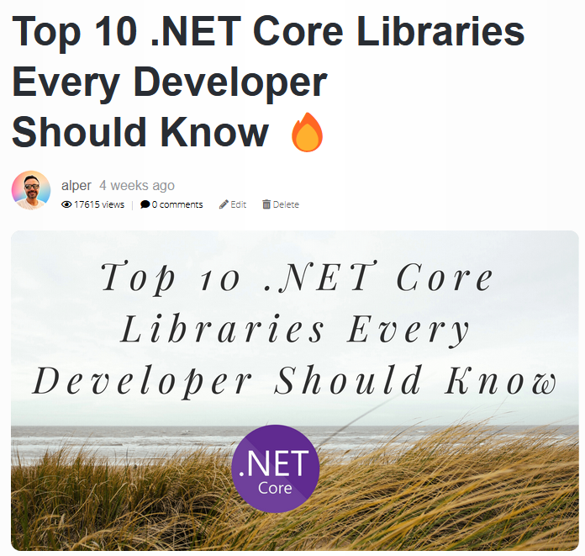
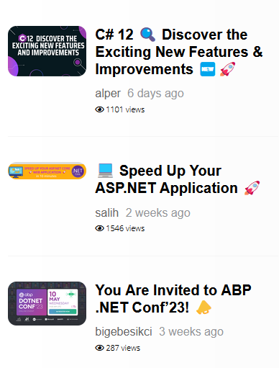
https://Blog.abp.io
Notes:
At blog.abp.io we share our experiences, C# tips, latest .NET features and news from other technologies.

Slide 21
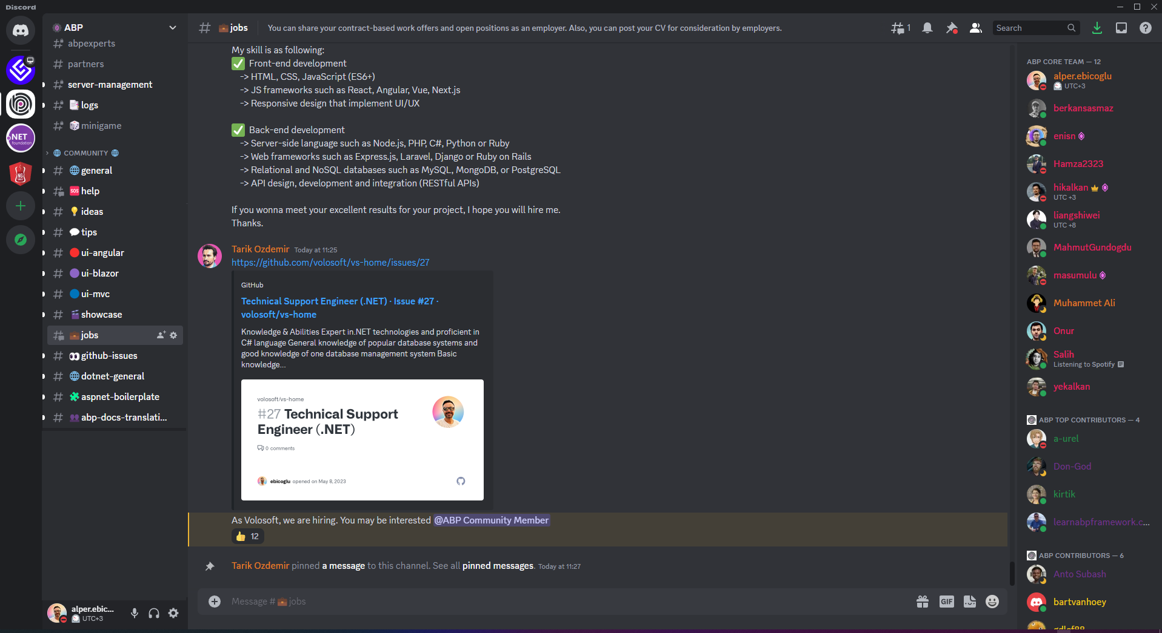
https://community.abp.io/Discord
Notes:
One of the key features of being a community is to bring the members together.
For this purpose, our Discord Server is the place where you can showcase your ABP projects, share the tips that worked for you, catch up with the latest news and announcements about ABP Framework, just chat with community members to exchange ideas, and have fun!

Slide 22
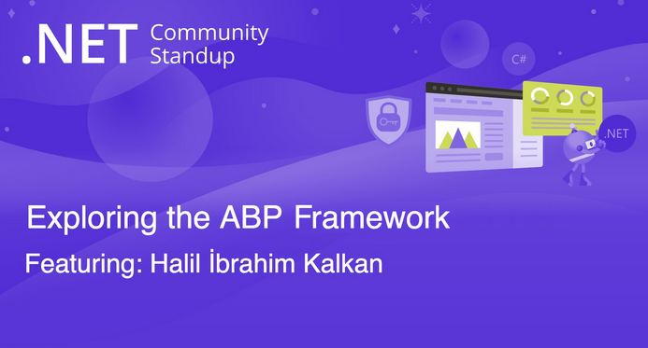
We’re also present at other events
Notes:
We also attend other events…
Microsoft .NET Community Standup

Slide 23
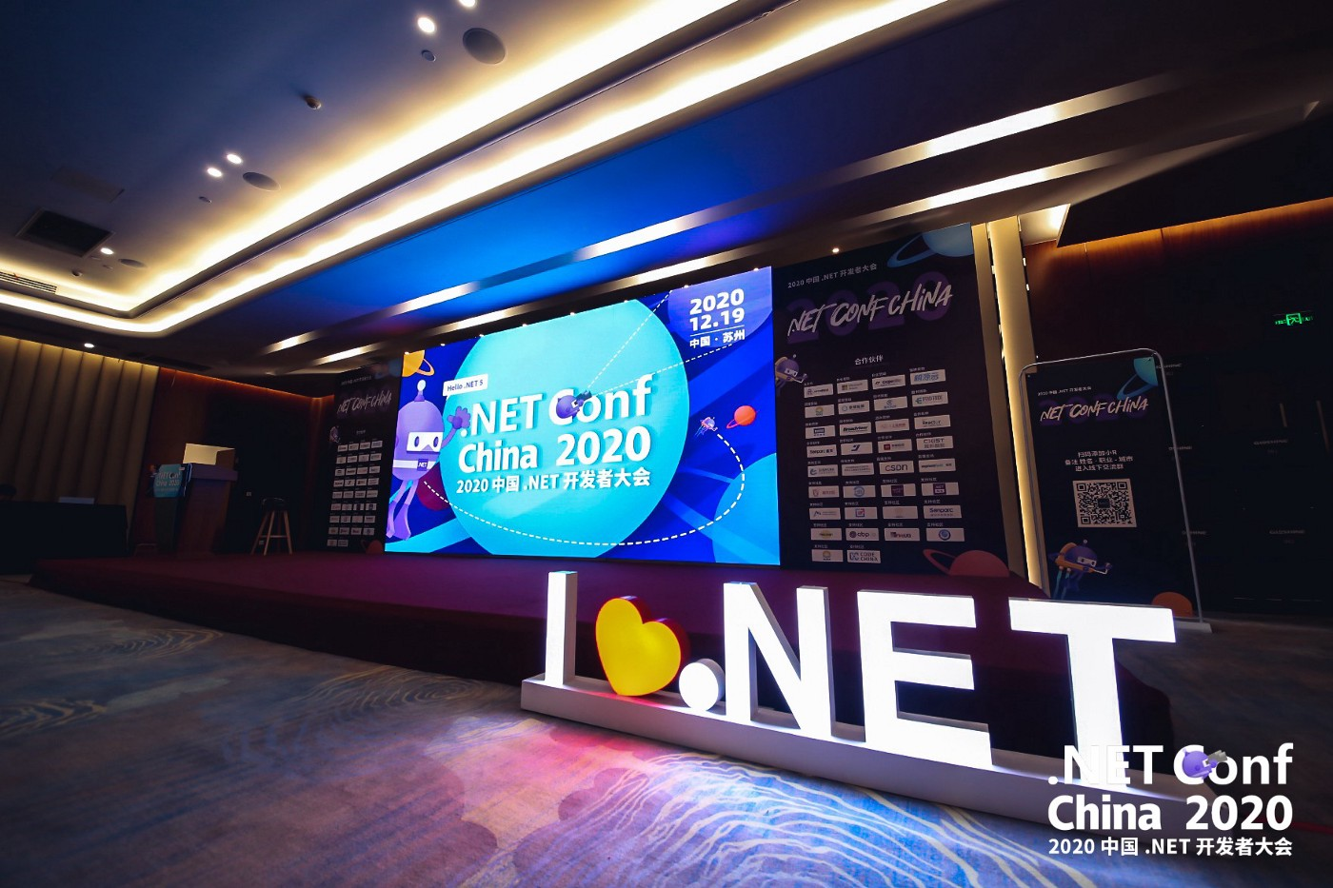
We’re also present at other events
Notes:
.NET Conf China

Slide 24
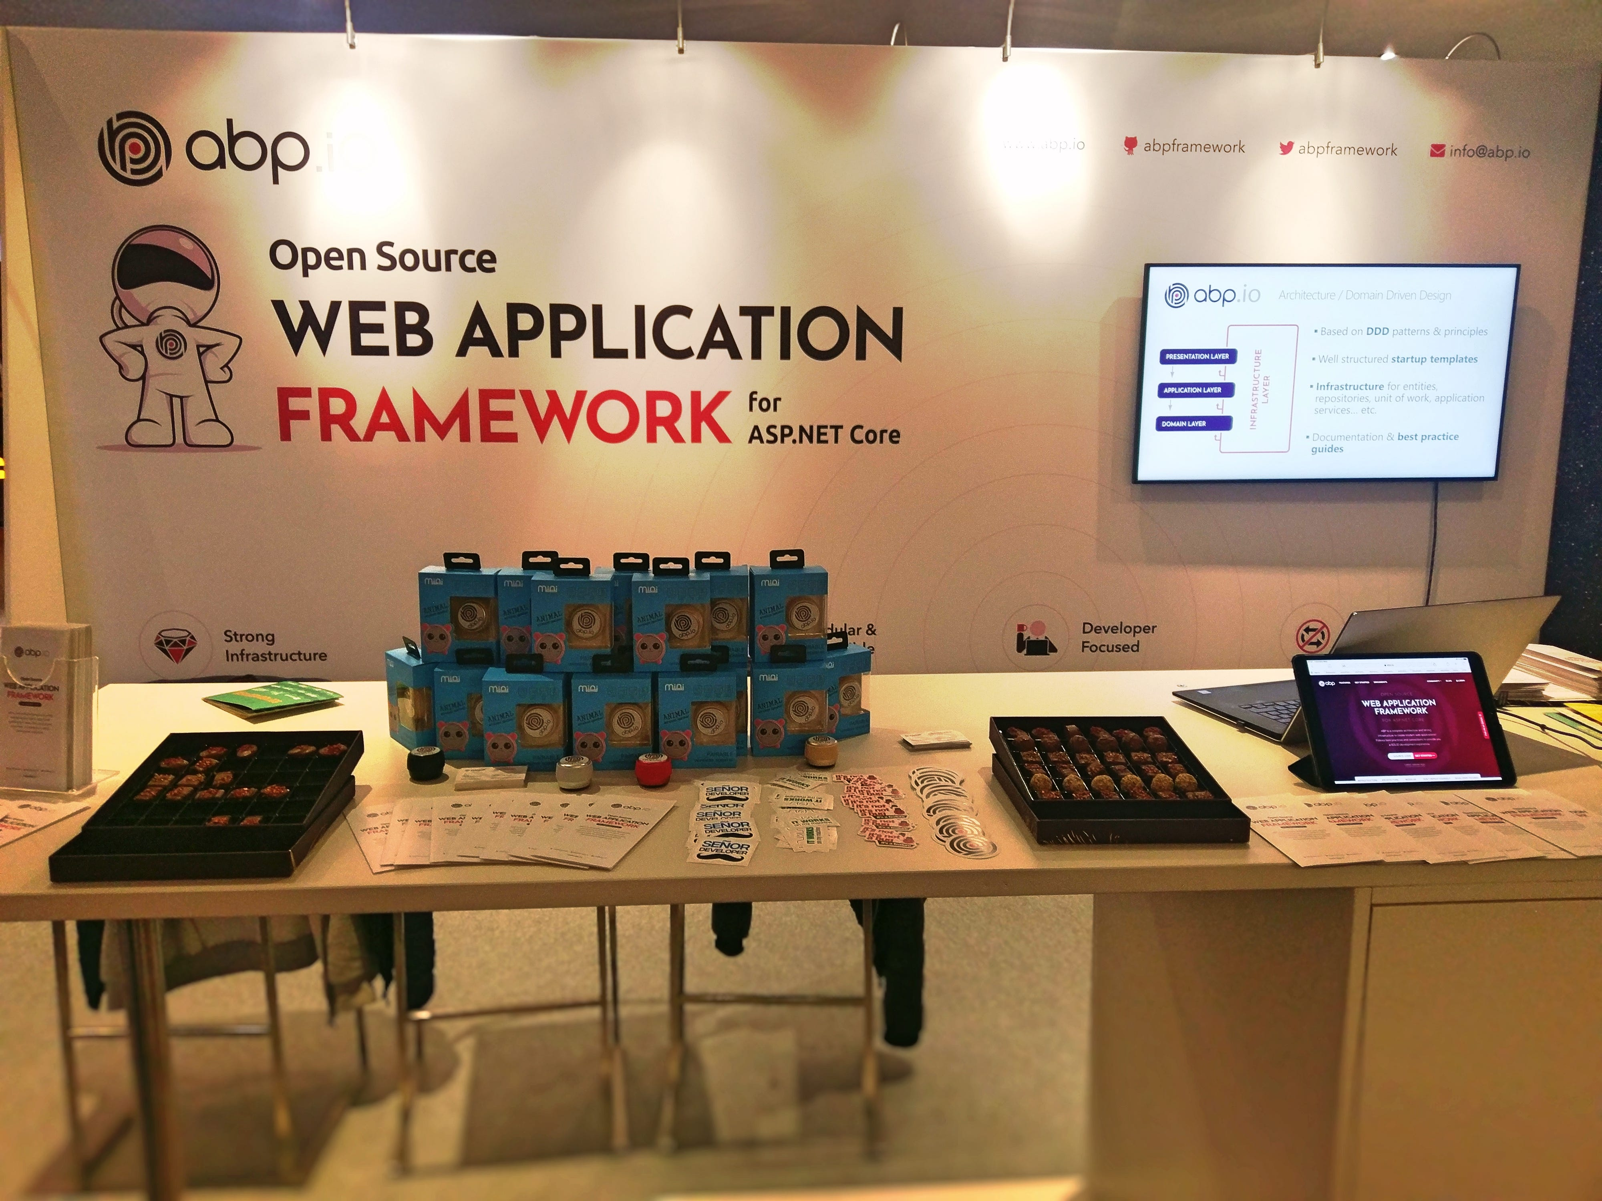
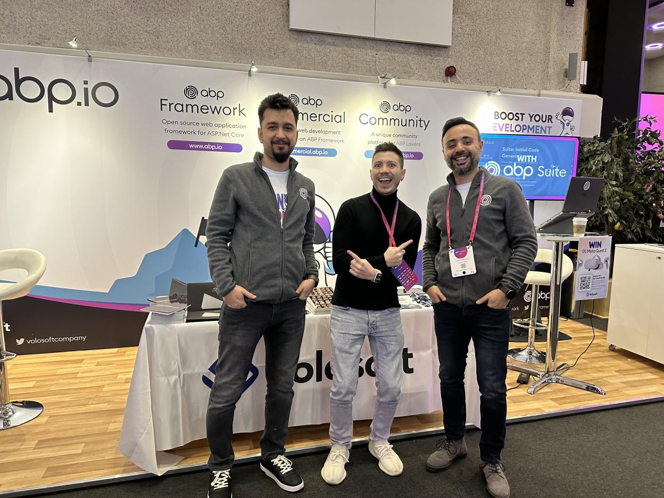
We’re also present at other events
Notes:
Every year we attend NDC London.

Slide 25
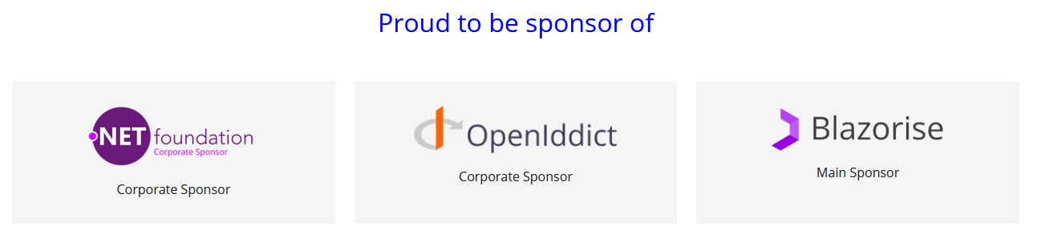
Notes:
We don't just deal with our products, we also contribute to the open source ecosystem.
As we benefit from the .NET ecosystem and give back by writing tools, articles and also sponsoring organizations like .NET Foundation, Openiddict and Blazorise.

Slide 26
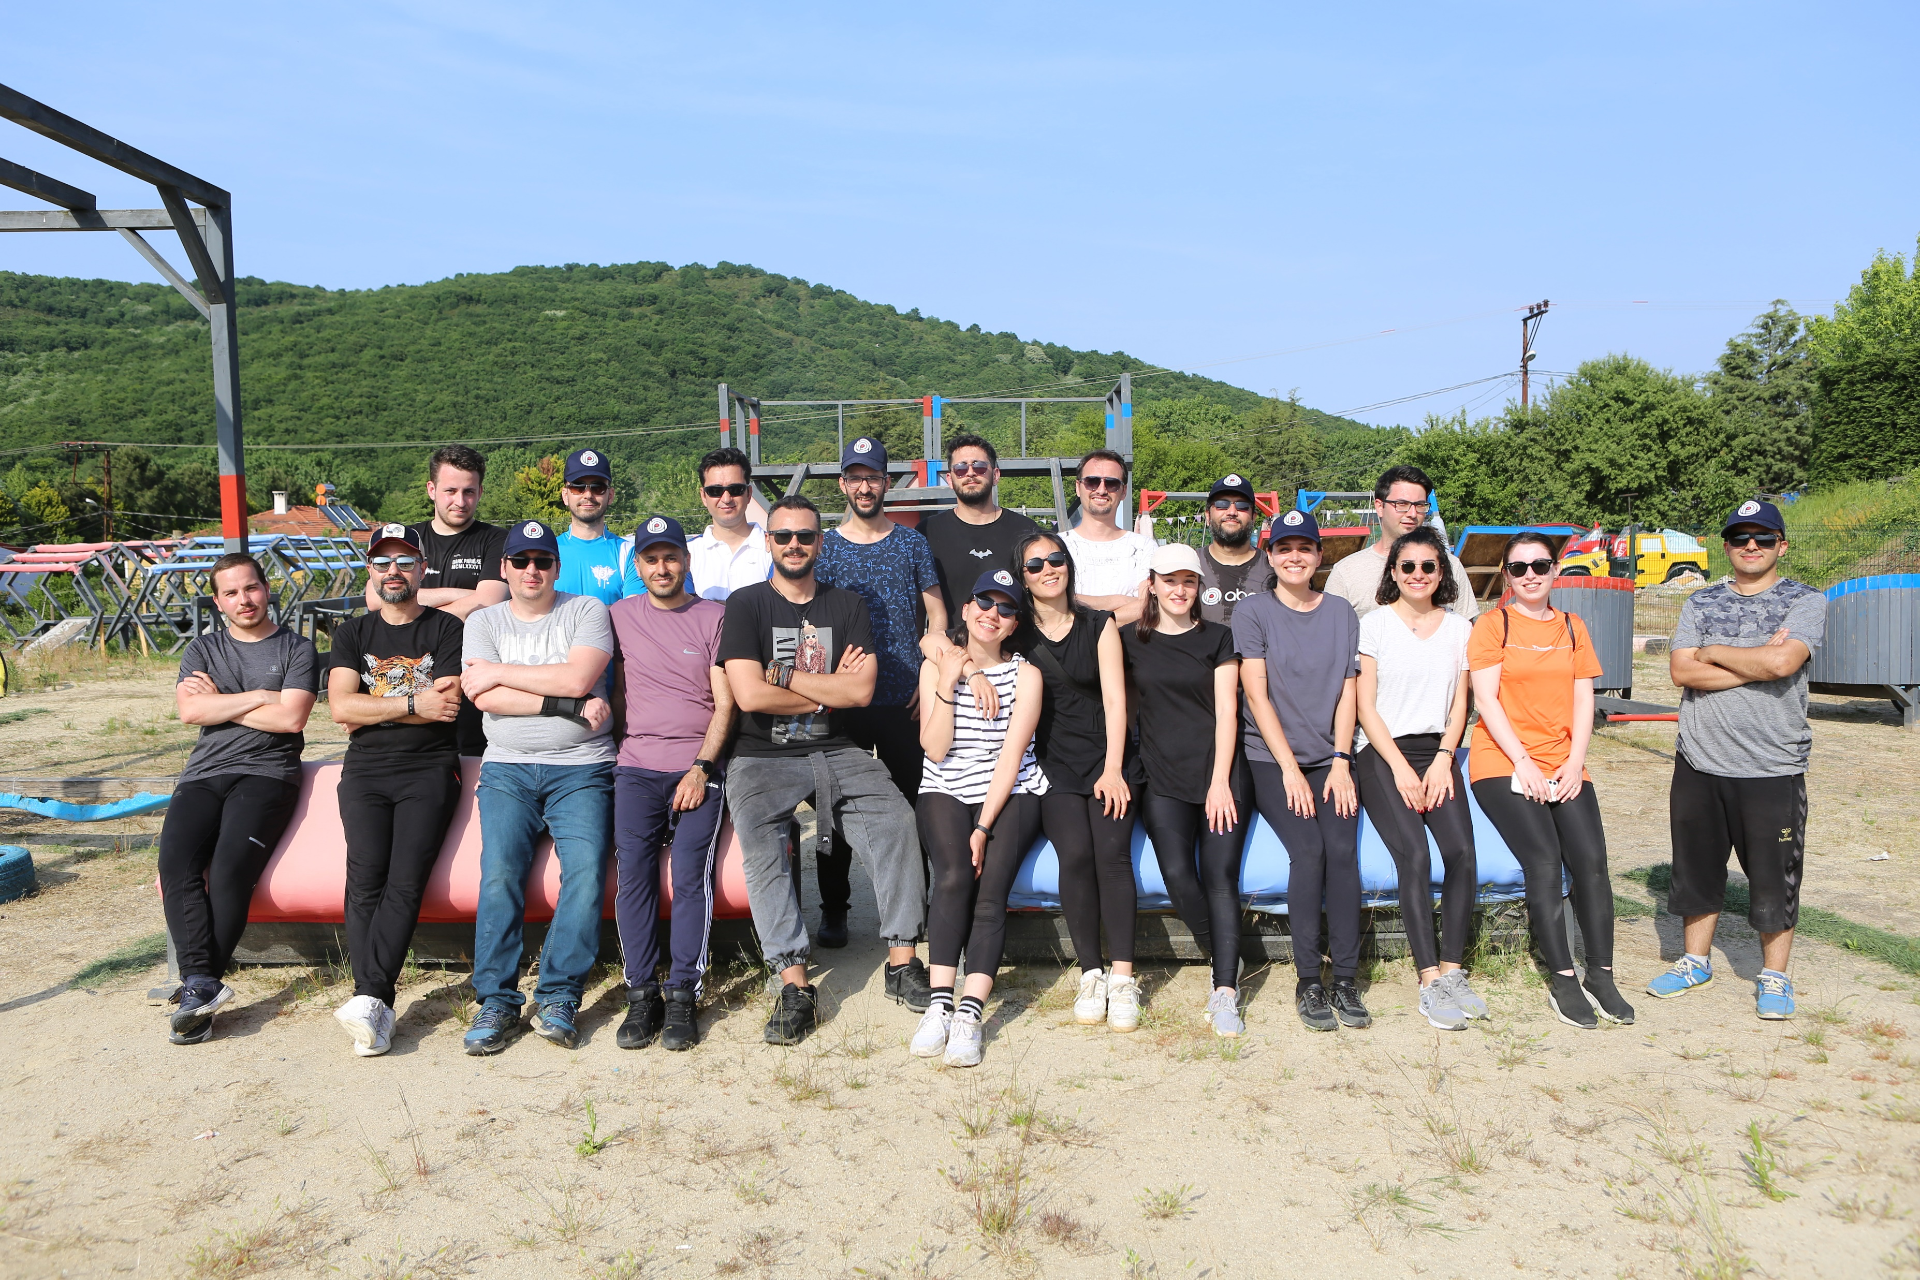
The Team
Notes:
And there is a very talented team behind these projects.
Thanks to all the team members and community members that made this product great.
I wish you an enjoyable conference today.

